Slide 1


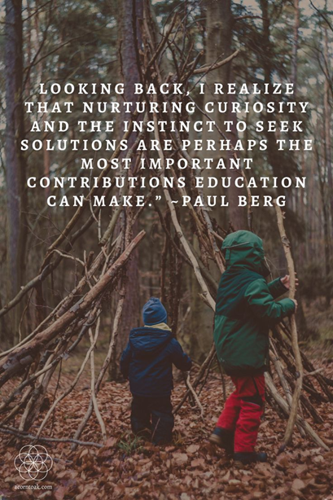
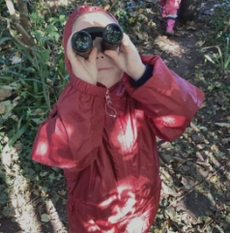


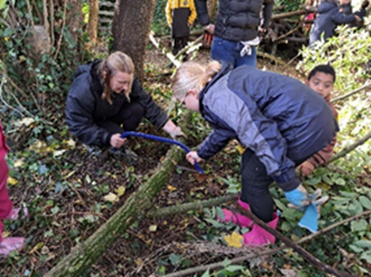
Who runs The Woodland?
Miss Monck is the lead and she has had lots of training and support from some external professionals including a level 2 forest school trained consultant (who worked with the school for 6 weeks when the project started) and the conservation manager from Nene Park Trust
Miss Monck also has the help from our Innovation Council which consists of many enthusiastic children who help gather pupil voice and assist with the upkeep and maintaining of the woodland. These children were chosen through a fair and unbiased process where they had to complete application forms.
What if it’s raining?
As with our OPAL ethos ‘There is no such thing as bad weather, only unsuitable clothing’
Our Woodland sessions will go ahead in almost all weathers as long as the children are warm and dry and wearing suitable clothing. Woodland sessions will only be cancelled if high winds, thunderstorms or very bad weather deem it to be unsafe. We have risk assessments in place for this and teachers will assess the ‘risk – benefit’ to these sessions. If the children are too cold and wet and not gaining anything from their experience then sessions may be cut short. However, if the children are enjoying themselves and still benefitting from their experience then it will continue.
Our Wonderful Woodland
Information for Families
What should we wear?
It is really important that your child is warm and dry during their woodland sessions. Children will get muddy, so should bring into school an old set of clothes to get changed into before their session.
In cold weather children will need: long sleeved T-Shirt, warm trousers, 2 pairs of socks, warm layers – sweatshirt, jumper, fleece, warm hat, a pairs of gloves, waterproof trousers and jacket, wellington boots. Most of these items are needed for our OPAL playtimes so do not worry because the same gear can be used for both!
We do have spares too, so please come and talk to your class teacher if you feel this is something we can help you with.
In warm weather: light cool clothing – long sleeved top, light weight trousers, wellington or other sturdy boots, sun hats, full waterproof gear may be required at times, although it is pretty shaded in there!
Biodiversity in our woodland
Birds of prey have been spotted overhead, such as, kites and buzzards and we are also spotting a range of tits and finches on our feeders, as well as the usual garden birds. We have 2 resident ducks who visit the pond regularly in warmer months. We have noticed the bird feeding stations that we have introduced have attracted many more birds to our site.
The Buddleias and lavender we planted last year attracted a huge range of butterflies and bees last summer and even a hawk moth!
We are currently planning to make our grounds more accessible for hedgehogs so they can use our newly built hedgehog homes and we have invested in wildlife cameras so the children can see who uses our grounds when no one is around. We also have some mammal tunnels that will trace the tracks of little feet!
Just outside of our woodland, we are in the process of preparing the ground for a wildflower meadow and you will notice the borders of our school field will not be mowed, all in aid of our local wildlife!
Our Woodland Project
The concept of Forest Schools has developed from the Scandinavian education system and is about children experiencing the natural world and learning outdoors. Children learn from first hand experiences and will develop skills like perseverance, independence and responsibility which will help to build self esteem. These skills will also help children to achieve more when they are back in the classroom.
In 2024, we decided that we had such an amazing space in our school grounds that wasn’t being used as much as we would have liked so we took on Our Wonderful Woodland Project to help to enhance and embrace it, for all our children, local community and its wildlife.
Our goal was to ensure that everyone gets the opportunity to learn and explore in this wonderful, unique space regularly.

Slide 2
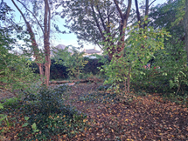
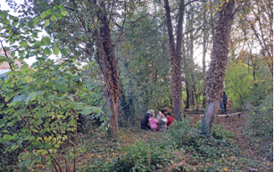
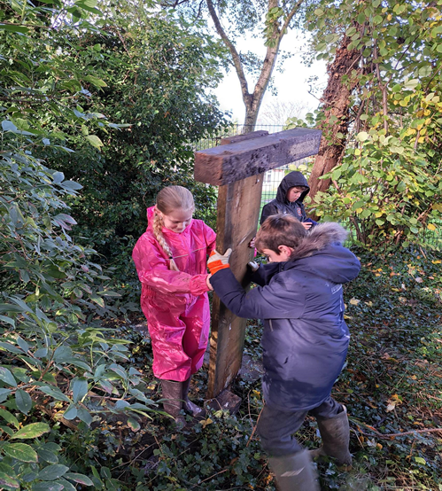
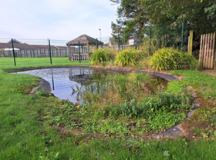

What is a woodland session like?
A Woodland Session will last around 2 hours and they take place every half term with parents being invited termly.
The session will always begin with a team game / warm up activity and then the session leader will explain the main activities available as well as talking through any health and safety issues to be aware of.
The children will then be free to explore the activities on offer and will have complete freedom to follow their own interests.
Each session will include activities that include the following: Mud kitchen, tools
and creativity. Other activities could include Den building, tree climbing and wildlife spotting, making leaf trails, going on scavenger hunts, making environmental art and mud sculptures and lots, lots more.
Earlier sessions will focus on core skills and safety; establishing boundaries and routines. As the children develop in confidence and familiarity with the environment the sessions focus on the development and consolidation of skills and understanding.
Teachers plan carefully for these sessions and they are closely monitored by the woodland lead.
f the group needs to come back together for any mini plenaries, this will involve an animal call of some sort, which the children will know to then come back to the group circle.
When the time comes, all involved will be expected to help with the tidying to ensure the woodland is maintained in its correct form. During parent sessions, they will be asked to tidy too!
At the end of every session, when everyone has come together, the leader will ask the children what they enjoyed or did not enjoy and also ask them what they would like in the next session – This will then be planned in for the next session.
How do we keep the children safe?
The health and safety of all participants is central to everything within a woodland session. In every session, 1 first aider will be in the woodland at all times and all staff involved will be made fully aware of the risk assessment, which is reviewed regularly. The site and activities are carefully assessed and the children are given detailed training for all activities.
What benefits will my child get from participating in our Woodland Sessions?
Outdoor learning supports the holistic development of the child: Health and fitness, being active in an outdoor, natural environment
Emotional wellbeing: Being outdoors and among nature has been shown to have a positive effect on our wellbeing
Social skills: Communicating, sharing, negotiating, problem solving, increased confidence
Skills development: Developing fine and gross motor skills and coordination for a real purpose
Knowledge and understanding – multi-sensory, real life learning, caring for green spaces and wildlife
Personalised learning - careful observations enable adults to tailor learning around interests and stage of development.
Lots of which the four walls of a classroom sometimes cannot cater for and we aim to do this whilst having lots of FUN!
Part of our Woodland Project is teaching children about risks and how to evaluate them. So the children will be taught about how to use tools safely etc. These activities will be introduced as the children in the group are ready for them and will be carefully supervised by an adult.
By allowing children to take these measured risks, we help to prepare them for making choices when they are older and teach them to be actively responsible for themselves and others, thinking carefully about their choices and actions.
How can I help?
Make sure your child has the right clothing for the weather.
Talk with your child about what they have done, often they will bring something home to show you.
Support our Wonderful Woodland by donating items that are needed to sustain our project or come along as a volunteer.

Slide 3
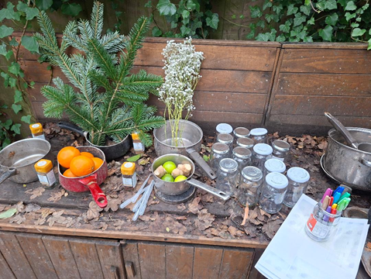
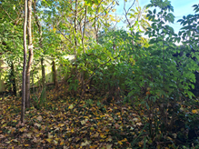
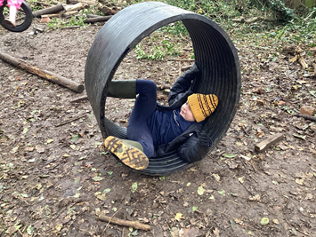
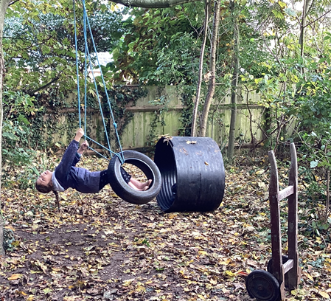
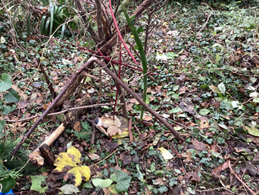

What has been the impact so far?
In 2024 we secured some funding from PECT which enabled us to purchase bird boxes, bird feeders and food, hedgehog homes, hammocks and slack lines as well as Native plants to help to increase the biodiversity in this beautiful habitat. There is a plan in place to increase this in the upcoming year and enhancing our pond area so watch this space!
Following a recent Pupil Voice study we noted the following:
100% of pupils enjoy their woodland sessions. Some responses were: It is fun. It is amazing and It is like extra play time but you learn things.
All children in the study could name many skills they have learn in these sessions. Key skills mentioned were: Leaning about habitats and dangerous plants and wildlife. How to build dens and climb trees. Safety around splinters(“ Do not touch sharp bits!”). Children also mentioned communication, stitching, spacial awareness, working with new people and team work and finding new ways to do things.
The pupil voice also heard how children can talk about the skills they learn in the woodland and how they can be transferred into the classroom such as: Following rules, working with other people, listening, friendships, challenges and resilience and building muscles in our hands.
Following a very positive recent parent voice:
100% woodland sessions help their children develop skills beyond the classroom
100% believe woodland sessions provide useful information and opportunities to engage with my child’s learning.
95% believe the woodland sessions are important to their child’s love for learning and development
95% enjoy the parent woodland sessions
95% say their children talk positively about their woodland experiences
91% have attended woodland sessions
82% believe the woodland communication is clear and informative
82% understand the key skills learnt during our woodland sessions
Our Next Steps: Your voice matters and we are listening.
Listening to the views of our children and parents, we have / are putting the following in place:
All dates for parent sessions are sent to parents at the beginning of each term to help parent’s organisation of work and other commitments
A new leaflet devised with all the relevant information to be shared to parents and families
Research and planning to look into barking the woodland floor to enable access in wet weather
Funding and grants to be looked into so we can further enhance the area and it’s wildlife
Regular newsletters celebrating session to continue but to also include key skills learnt and children’s thoughts and feedback
Woodland lead to visit Forest school settings for further ideas and inspiration
Further den building resources to be purchased, following pupil voice
Teachers to plan in more pond sessions for the children to explore, when appropriate due to higher staffing needs and increased pupil / adult ratios.
Unfortunately, we have looked into allowing siblings to join our sessions and due to risk assessments and activities being planned for, we are unavailable to cater for this for the time being.

